Slide 1
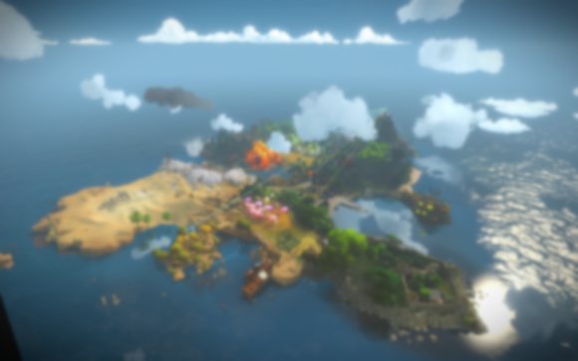
Simple Sharing of Ideas
Zou Chenxue(Tim)
-Luma Pools

Slide 2
What needs to be solved
After drawing one tile, calculate the best way to discard tiles. When the opponent discard one tile X, decide whether CHOW/PUNG/KONG.
Add X to my tiles to form 14 tiles, and then calculate the best tile to discard. If the tile discarded is not X, choose CHOW/PUNG/KONG
Declare Mahjong to win.

Slide 3
Information and Evalution
Not consider the 3 opponents' unidentified tiles
Only consider my own 14 tiles and all the tiles on the table as information. (How to guess?
My evaluation of the way that the tiles are discarded could be represented by a graph.

Slide 4
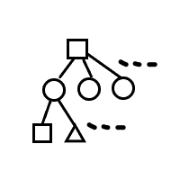
Evalution Graph
Circle shows the state of 13 tiles.
Square shows the state of 14 tiles.
Triangle shows the state of 14 tiles that can be declared Mahjong.
A square is connected to no more than 14 circles, which are the states of the remaining 13 tiles after enumerating the tile discarded.

Slide 5
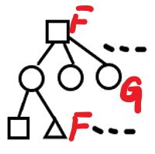
Evalution Graph
Use F(X) to represent the estimated value of the state where 14 tiles are recorded as X. G(Y) to represent the estimated value of the state where 13 tiles are recorded as Y.
F(X)=max{G(Y1),G(Y2),…,G(Y14)}
For the triangle state X0, F(X0) equals to the final score.

Slide 6
Evalution Graph
Define the transition probability P(Y,X) as the transition probability of Y to X. (Get the certain tile X-Y)
Enumerate the tiles that are still remained and calculate the probability of the needed tile on CHOW/PUNG/KONG/Make Mahjong or self-DRAW.
The situation where tiles cause the game to end is recorded as P(Y).

Slide 7
Evalution Graph
A penalty value needs to be set when game ends, which is set as an unknown constant C.
G(Y)=P(Y,X1)F(X1)+P(Y,X2)F(X2)+…+P(Y,Xn)F(Xn)+P(Y)*C. (n < 34)
For P(Y,X), the probability of DRAW is the number of needed tiles divided by the total remaining number.

Slide 8
Evalution Graph
For CHOW/PUNG/KONG/Make Mahjong, judge whether Y meets the condition.
One extra addition to P(Y,X) if it meets one.
P(Y) is estimated as a function that monotonically increases with the current round number.
In this way, after calculate these F(X), G(Y), my bot can get a very rough figure of which tile to be discarded.

Slide 9
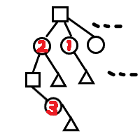
Optimization
There is a good optimization space for max, and P(Y,X) is usually less than 1/10.
When calculate G(Y), if Y needs d tiles to Make Mahjong, the states of distance > d+1 can be directly ignored. (The distance that between G(Y) and the nearest triangle state is d)
In the figure, the calculation of circle 1 does not need to calculate circle 3.

Slide 10
Optimization
For the top square, in the comparison between circles 1 and 2, the contribution of circle 3 doesn’t make much difference.
If the difference of 1/10 is not too large, one more layer can be considered.
In the implementation, I try to calculate one more layer within the time allowed.

Slide 11
Final Implementation
Enumerate some triangle states that are close to the current 14 tiles and find the intermediate state of the transfer path and the state of the surrounding layer.
Get the calculation with these fewer states.
Some special tile types can be enumerated separately. (It spends little time)
Combined with my 14 tiles, the search process can be optimized with the level of probability.

Slide 12
Final Implementation
Other normal tile types can be enumerated together.
Use some simple enumeration and artificial common strategies at the beginning of the game.
The most "isolated" tiles are usually discarded.
Some of the coefficients mentioned earlier.
Set them to relatively ordinary values without a lot of testing and modification.

Slide 13
About strategy
P(Y) does not simply change with the number of rounds.
It is related to the tiles discarded.
Avoid discarding dangerous tiles when there are many rounds.
F(X)=max{P(X-Y1)G(Y1),P(X-Y2)G(Y2),...P(X-Y14)G(Y14 )}
P(X-Y) represents the probability that the tile is discarded safely.
Only for making a comparison with P(X-Y) to decide which tile to discard.

Slide 14
About strategy
This part is very subjective, and the effect is not good.
I gave up this strategy.
The probability of making opponent win has been reduced, while sacrificing a better way of discarding tiles to Make Mahjong.
If the opponent knows this defensive strategy, it is easy to find countermeasures and make my strategy useless.

Slide 15
Summary
The strategy should not be designed to be constant.
It needs to have the ability to recognize other opponents' strategies.
I don’t have good way to do this.
My bot still has a lot of things to be finished and improved.
Other methods may have a better effect than a zero-start search.
Thank you!

Slide 16
The End The Start

